Slide 1
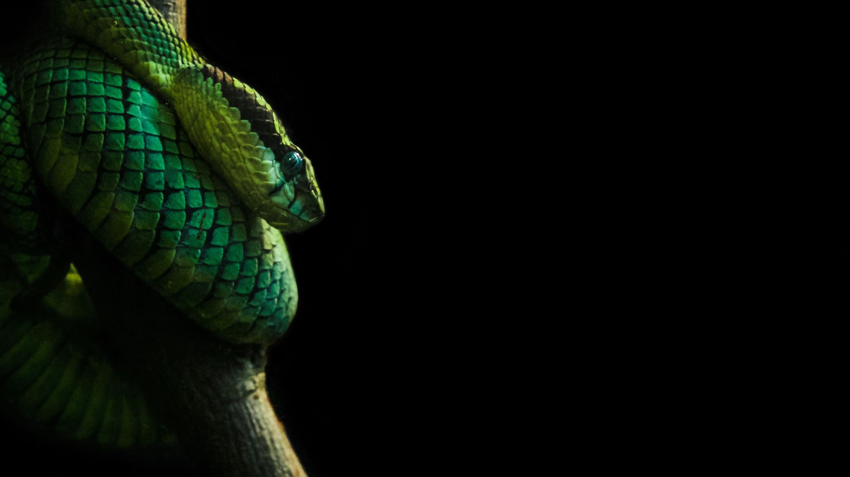
Python Concept: Functions
Presented by :
Harvin Kaur
Hargun Singh Oberoi

Slide 2

What is a Function?
A function is a block of code that performs a specific task. It runs only when it is called.
Why are Functions used?
To avoid repeating code
To make programs clean and structured
To reuse logic easily

Slide 3
How it is defined
def function_name(parameters):
# code block
return result
When are Functions used?
Functions are particularly used when the same task needs to be performed multiple times, helping to avoid code repetitions and improve efficiency.

Slide 4
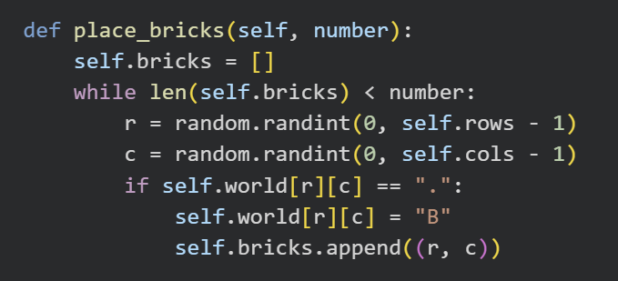
Example of function from our robot game

Slide 5
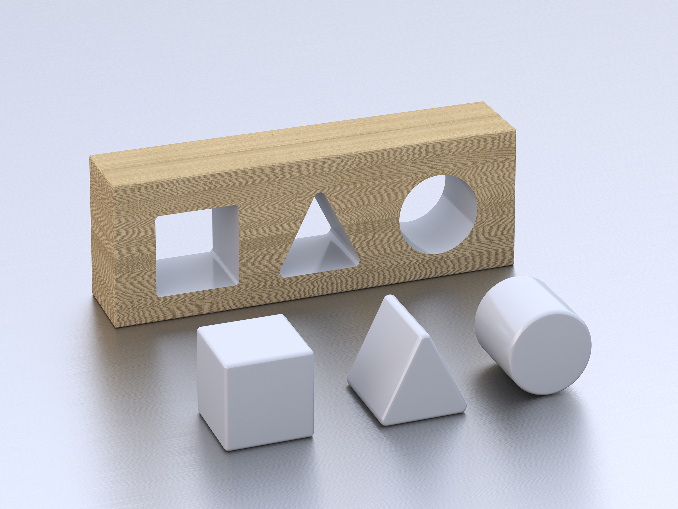
Explanation of what the function does.
It runs until the required number of bricks is placed.
It generates random row and column positions.
It checks if the position is empty (".").
If empty, it places a brick ("B") in the position.

Slide 6


